Slide 1
Reproducible Analytical Pipelines: JSNA Hub
Annie Yu, Emma Wells
Public Health Intelligence Team, Camden Council

Slide 2

Background
Who are we?
The aim of the Public Health Intelligence is enable high quality decision making that maximises population wellbeing using evidence-based actionable insights derived from analysis, research, and evaluation.
What do we do?
As part of the analytical function in PHI, we use a variety of data sources to conduct analyses and produce figures, data viz, reports, dashboards, and more to help inform services and decision makers within Camden.
Where do we publish?
The JSNA (Joint Strategic Needs Assessment) is a collection of different types of product that collectively represents the basis for health decision making within Camden.

Slide 3
Reproducible Analytical Pipelines (RAP)
Automated statistical and analytical processes ensuring reproducible, auditable, efficient, and high-quality outputs.

Slide 4
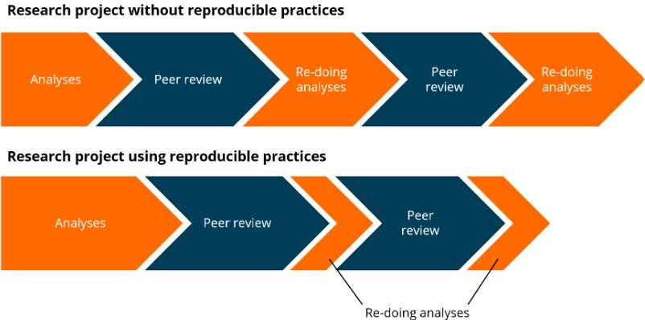
Reproducible analytical pipelines
Why use RAP?
Reproducible
Consistent quality
Time saving
Collaborative and open source (whenever possible)
Version controlled

Slide 5
Reproducible analytical pipelines
Why use RAP?
Reproducible
Consistent quality
Time saving
Collaborative and open source (whenever possible)
Version controlled

Slide 6
Reproducible analytical pipelines
Why use RAP?
Reproducible
Consistent quality
Time saving
Collaborative and open source (whenever possible)
Version controlled

Slide 7
Reproducible analytical pipelines
Why use RAP?
Reproducible
Consistent quality
Time saving
Collaborative and open source (whenever possible)
Version controlled

Slide 8
Reproducible analytical pipelines
Why use RAP?
Reproducible
Consistent quality
Time saving
Collaborative and open source (whenever possible)
Version controlled

Slide 9
Tools
Key tools for RAP
Any open-source programming language such as Python or R
Git or any other version control software
Data security measures and training

Slide 10
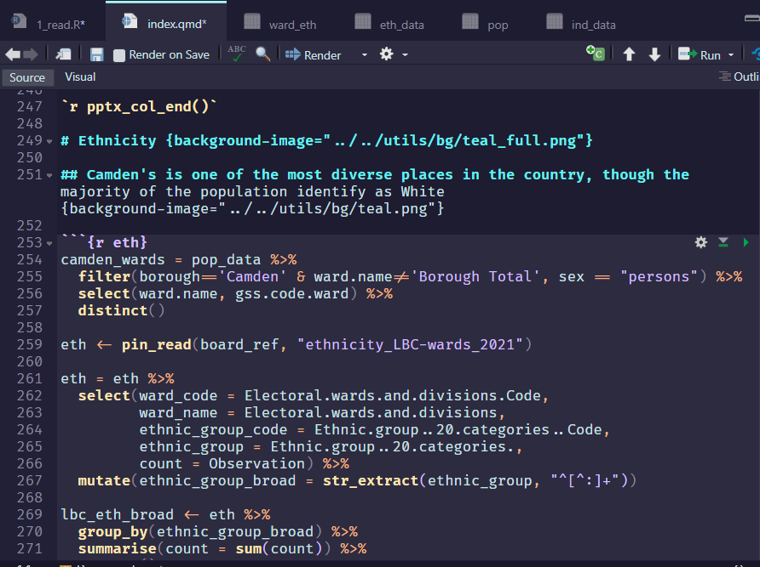
Tools
Key tools for RAP
Any open-source programming language such as Python or R
Git or any other version control software
Data security measures and training

Slide 11
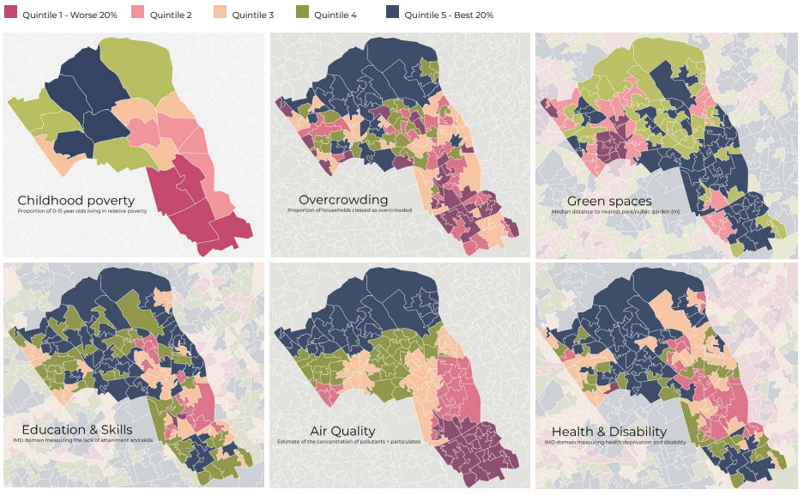
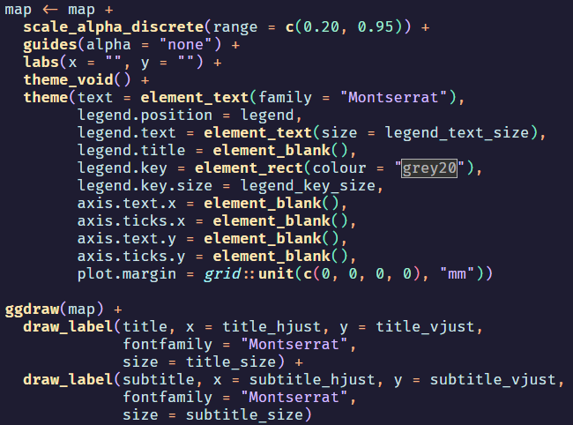
Tools
Key tools for RAP
Any open-source programming language such as Python or R
Git or any other version control software
Data security measures and training

Slide 12
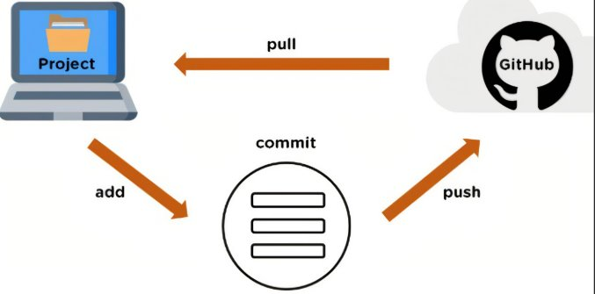
Tools
Key tools for RAP
Any open-source programming language such as Python or R
Git or any other version control software
Data security measures and training

Slide 13

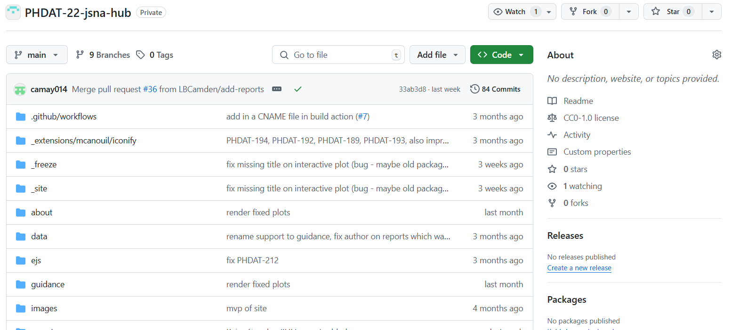
Tools
Key tools for RAP
Any open-source programming language such as Python or R
Git or any other version control software
Data security measures and training

Slide 14
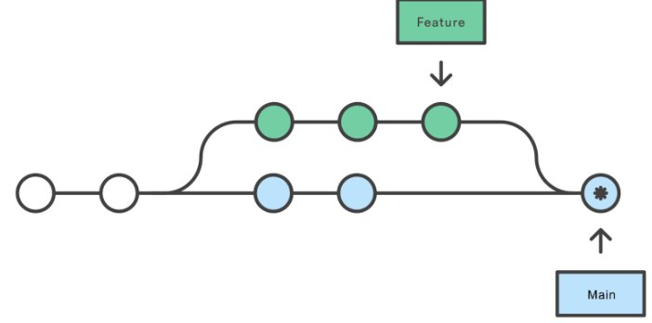
Tools
Key tools for RAP
Any open-source programming language such as Python or R
Git or any other version control software
Data security measures and training

Slide 15
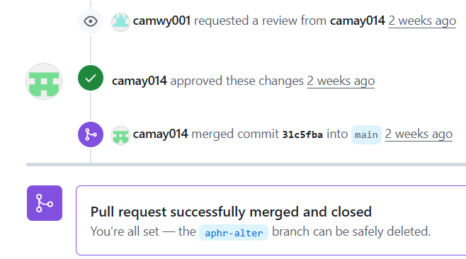
Tools
Key tools for RAP
Any open-source programming language such as Python or R
Git or any other version control software
Data security measures and training

Slide 16
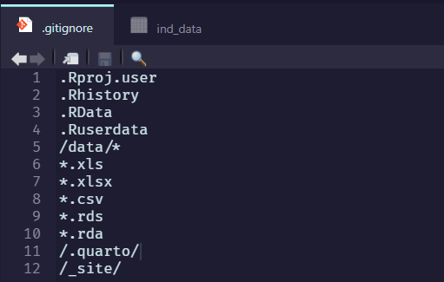
Tools
Key tools for RAP
Any open-source programming language such as Python or R
Git or any other version control software
Data security measures and training

Slide 17
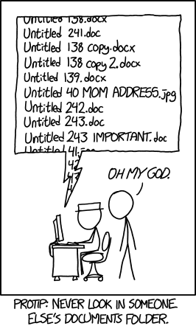

Slide 18
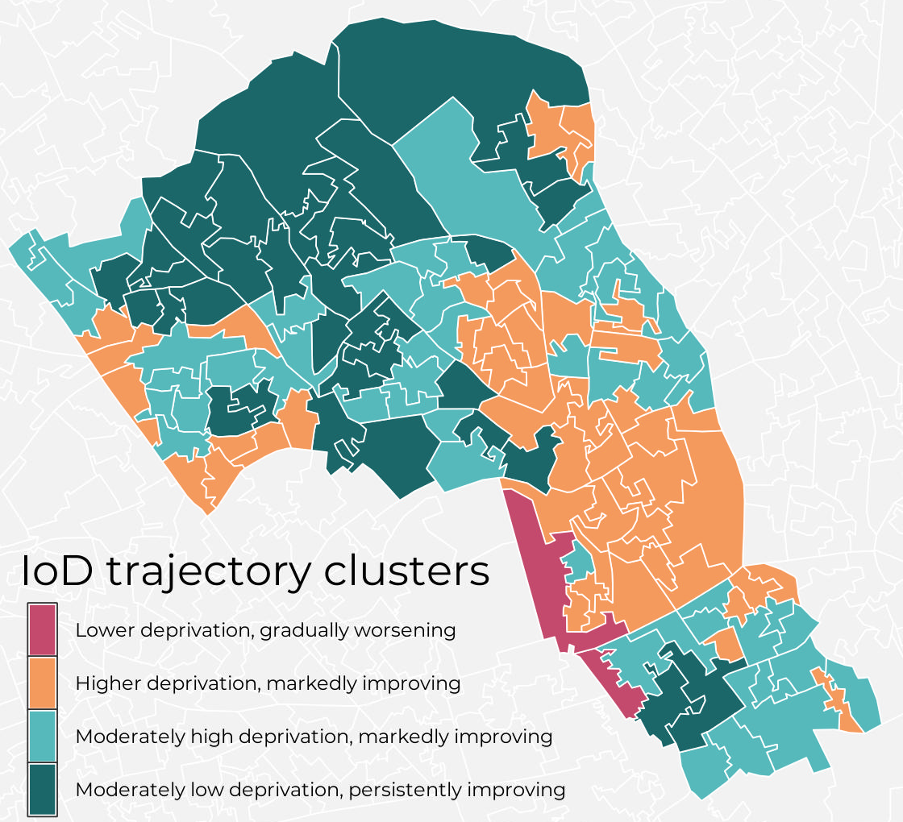
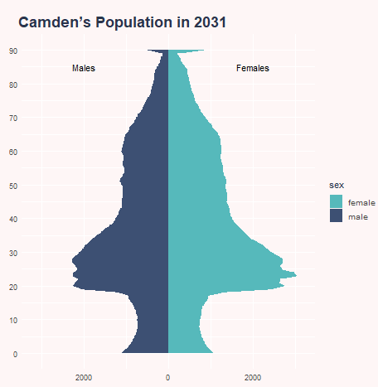
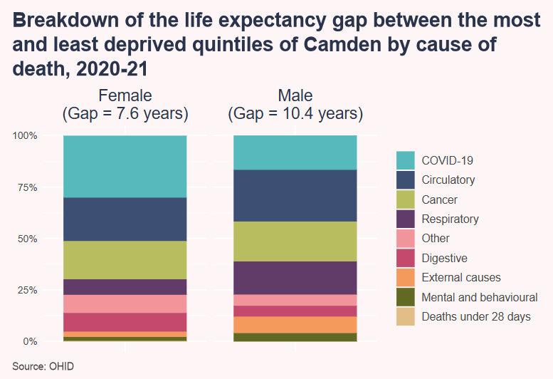
Reproducible analytical pipelines
Possible outputs:
Figures
Charts, maps, and other data visualisations
PDFs, Word documents, PowerPoint presentations
Interactive charts, maps, tools, and dashboards. (as .html files or hosted apps)
Webpages and blogs (need hosting)
Packages

Slide 19
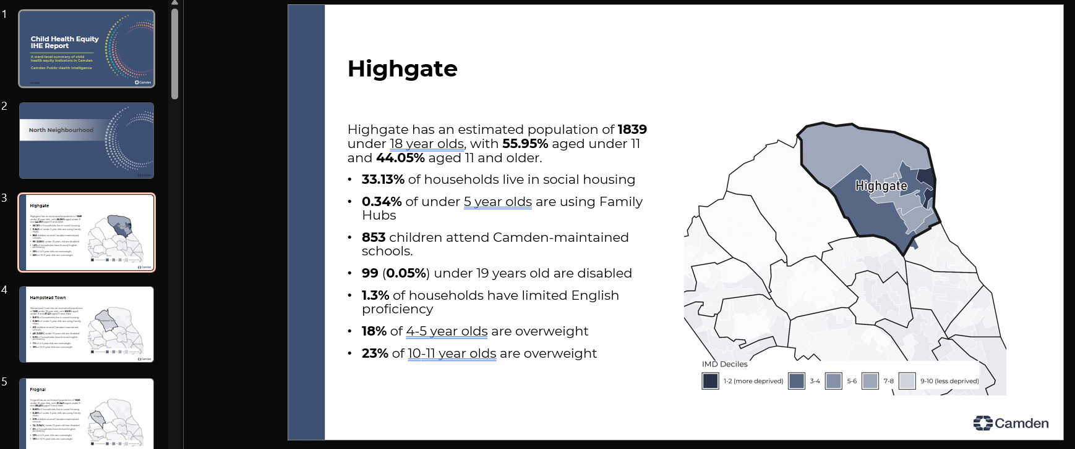
Output examples

Slide 20
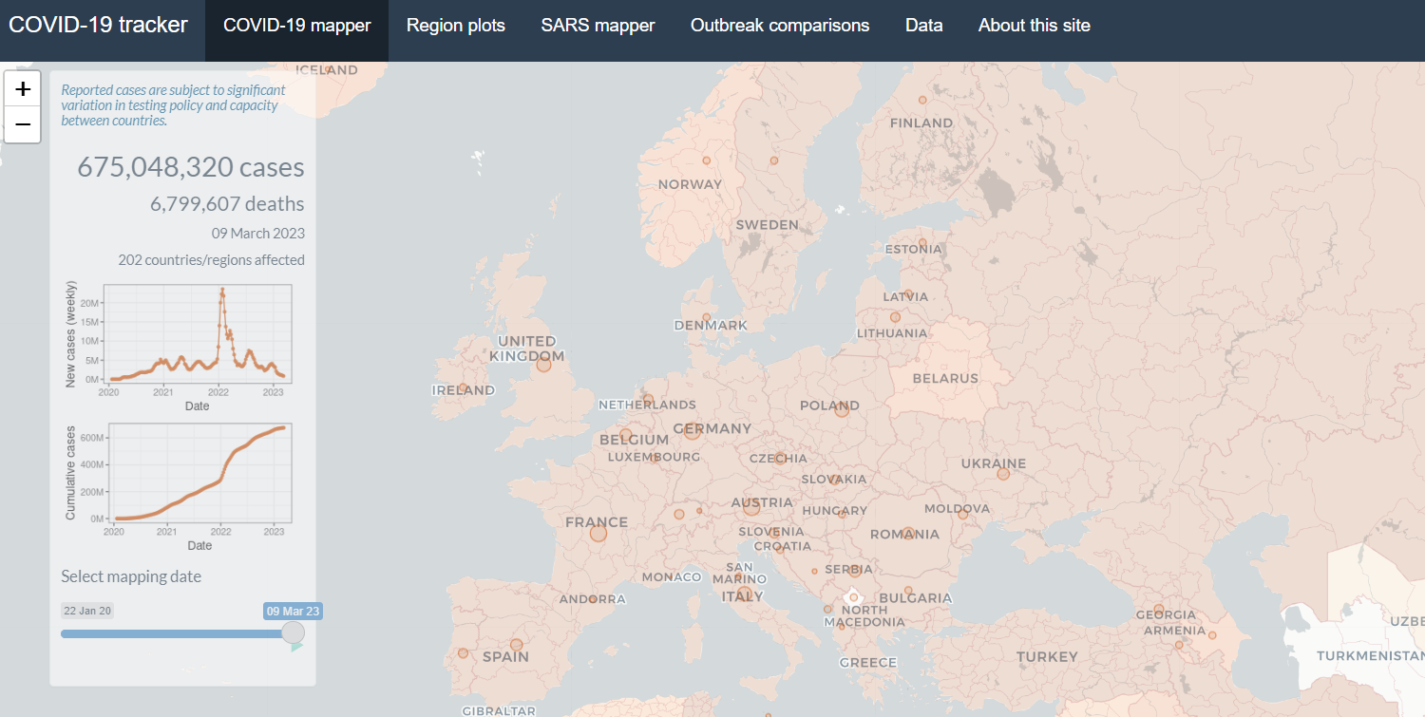
Output examples

Slide 21
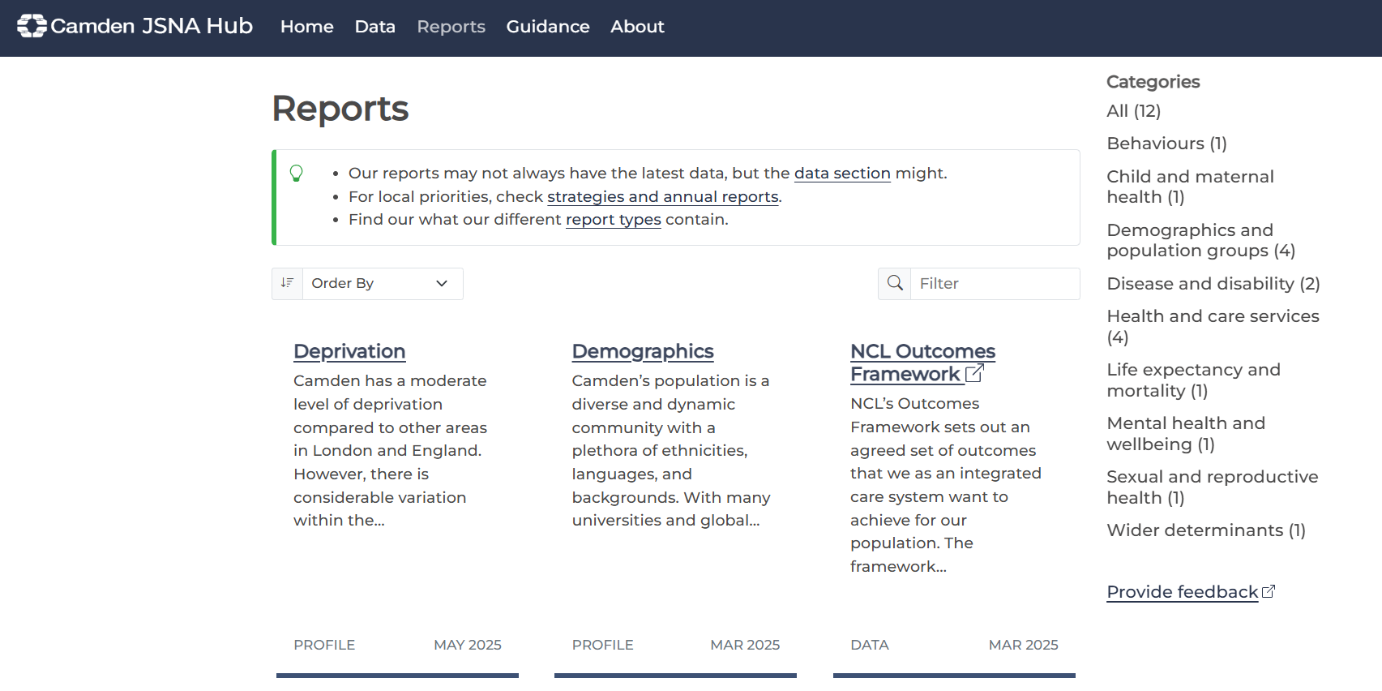
Output examples

Slide 22
The JSNA Hub

Slide 23

Background – Joint Strategic Needs Assessment (JSNA)
Producing a JSNA is a statutory requirement for public health teams in local government
The JSNA is an assessment of the current and future health and social care needs of the local community
The core aim is to develop local evidence-based priorities for commissioning which will improve the public’s health and reduce inequalities.
Reports to the Health & Wellbeing board
Informed by quantitative and qualitative data analysis
Previously separate reports but nothing comprehensive and relied on manual processes

Slide 24
Our approach – The Hub
The JSNA (Joint Strategic Needs Assessment) Hub is a collection of different types of product that collectively represents the basis for health decision making in Camden. No individual product is ‘a’ (or ‘the’) JSNA.
There are a core set of products that, as far as possible, follow a consistent structure. There are additional products that deviate from this structure though remain aligned to it.
The JSNA hub is:
visible to all (public website/microsite) and accessible
easy to navigate and discover
wherever possible, allows for reproducibility

Slide 25


Core products
Short desk-based thematic overviews of core topics such as life expectancy, LTCs, or demographics that provide a brief summary of a topic for Camden
Health Needs Assessment (HNA)
Rapid desk-based overviews of the needs of a specific group or users of a service (e.g., autism, homeless, cancer) with actionable recommendations
JSNA CHAPTER
Similar to a HNA but developed with substantive stakeholder engagement such as with residents, VCS, staff, and NHS partners
PROFILES
Taken to HWB Board and included on forward plan
Other products include briefings, dashboards and tools

Slide 26
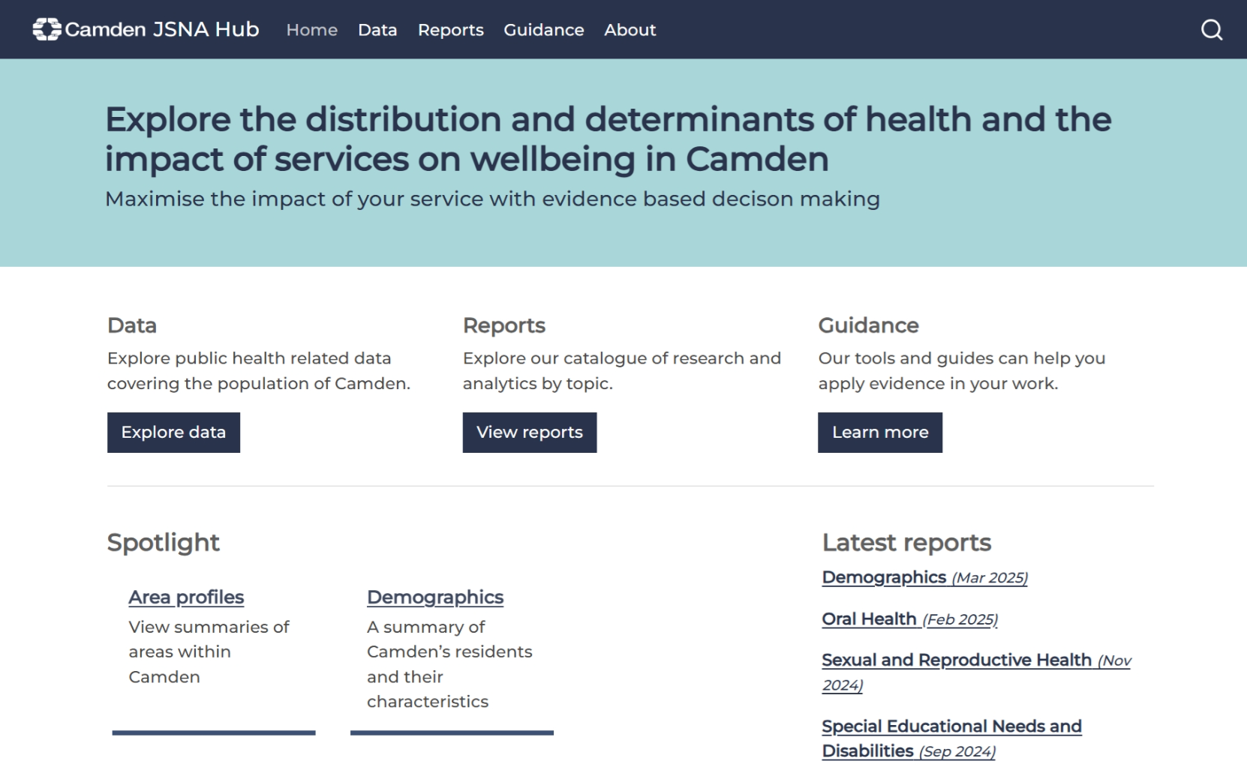
JSNA Hub
jsna.camden.gov.uk

Slide 27
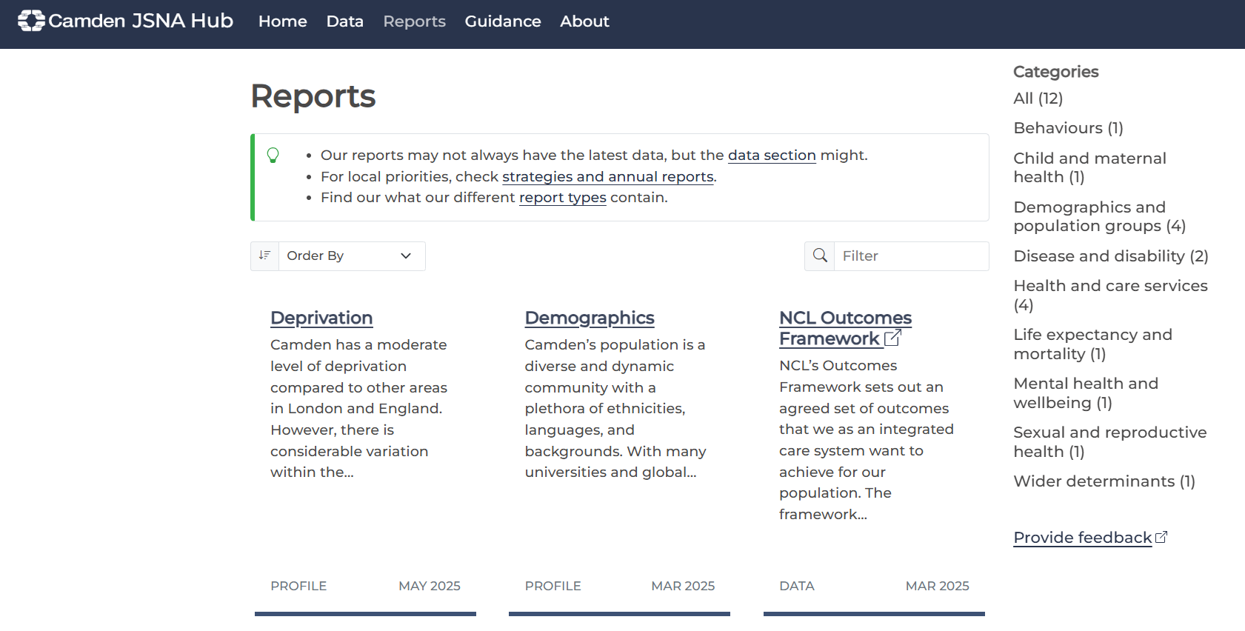

Slide 28
The Workflow

Slide 29
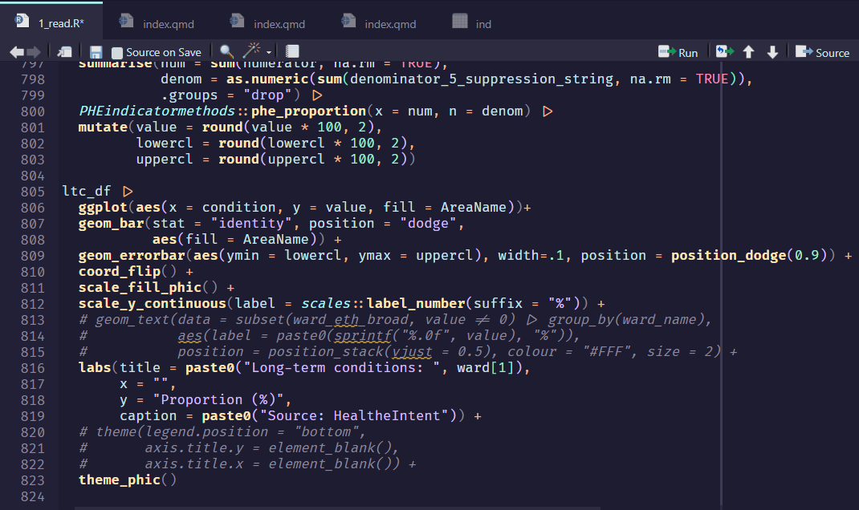
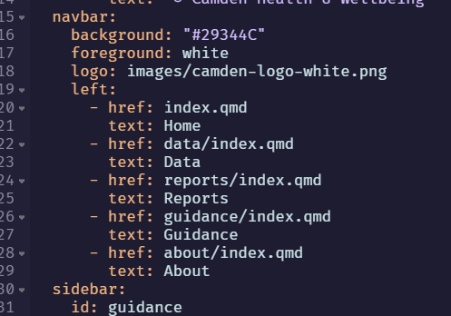
Adding or modifying content
Create a new script or modify an existing script
Reference that script in the YAML (determines the site structure)

Slide 30
JSNA Hub: Using GitHub
Create a branch & write your code
Make your changes in a separate branch
Commit
Save your changes locally
Push Commit
Send your changes to GitHub repo
Pull Request
Ask someone to review the code
GitHub Security Checks
If automatic checks fail, the commit fails and is not published
Pull Request Approved = Commit Merged & Published
Success! Your code is live and the JSNA site has been updated

Slide 31
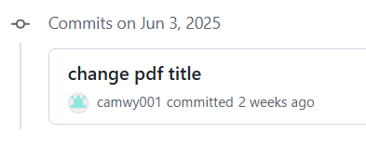

JSNA Hub: Using GitHub
Safe as houses:
Make your changes on a separate "branch" so it's impossible to break the existing code and website
A review by another member of the team must be completed first before the push can be “merged” into the live version of the website.
GitHub will not allow the code to be published if it fails the security check

Slide 32
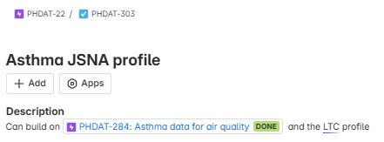
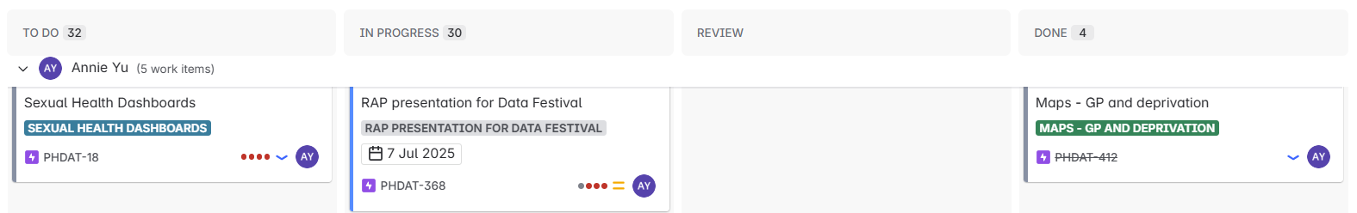
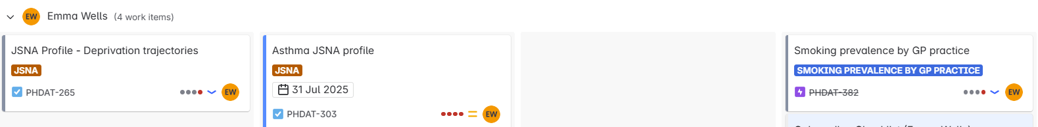
JSNA Hub: Managing workload
We use Jira to keep track of our tasks and visualise our workload using kanban boards
Agile project management is usually recommended to accompany RAP

Slide 33
Resources
RAP:
Core Principles of RAP
RAP Companion
RAP case studies
R:
NHS-R: Slack Community
NHS-R: Intro to R and RStudio material
NHS-R: Events
Intro and Intermediate R workshops (typically monthly)
Coffee & Code
Interactive Intro to R (datacamp)
Quarto Tutorial
Git:
Introduction to Git

Slide 34
Thank you!
publichealth.intel@camden.gov.uk
https://jsna.camden.gov.uk/

